Slide 1

Python: Level 2
Session 1: Welcome (back).

Slide 2

About this Course
Who am I?
Who are you?
Course Aims

Slide 4
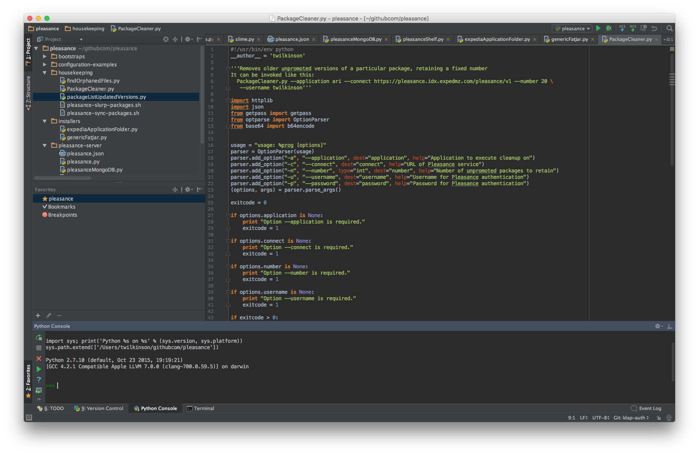
Recap: What do we need?
Python: version 3.5.x (or better)
A text editor:
Visual Studio Code
Sublime Text
PyCharm Community Edition
Anything with syntax highlighting for Python
Do not use:
Notepad
Notepad++

Slide 5
Recap: What went before
Take a look at http://eca-python/l2session1
Download it and open it in your preferred editor
Let’s work through what it does.

Slide 6
Recap: What went before
Take a look at http://eca-python/l2session1
Download it and load it into your preferred editor
Let’s work through what it does.
restaurants-lesson1.csv is at: http://eca-python/restaurants.csv

Slide 7
What doesn’t it do?
What restrictions should be on the inputs?
Can you add a restriction to only allow the user to input numbers between 1 and 5 when searching on rating?

Slide 8
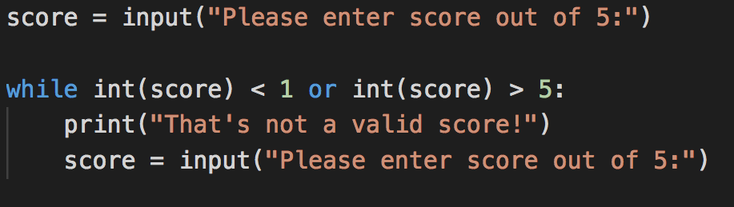
Did you come up with something like this?
Great! But there’s still a problem. What is it?

Slide 9
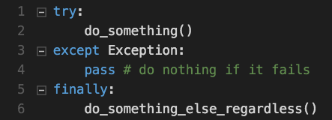
Let’s make an exception!
Try to do something
If that fails do something else (or don’t)
Finally, optionally, do something else
You can have multiple except blocks for different exceptions

Slide 10
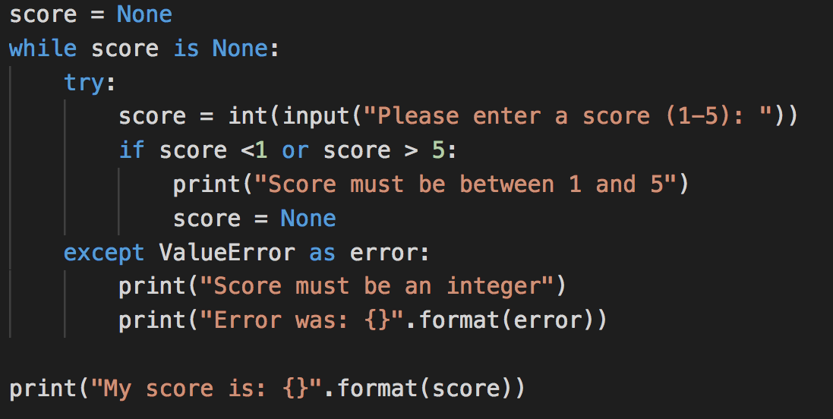
What does this do?

Slide 11
Exercise / Next week’s Class
Can you add input validation?
If I enter something that isn’t a number, print an error and ask again.
Next week: Building a library, no Dewey Decimal system required
Slack channel: #python-london-eca
Notes:
Extra credit: what happens if there’s no data file when we run our program? How can we change the code so that isn’t a problem?

